Slide 1
SMART OXYGEN AND TEMPERATURE CHANGER FOR CAR
Submitted By
Suhina Banga 1NT15CS182
Pratibha Kumari 1NT15CS121
Junaid 1NT15CS068

Slide 2
Description
SMART OXYGEN AND TEMPERATURE CHANGER FOR CAR 2017-2018
Detects the oxygen level in the car and switches on the buzzer and display on the Led Display
Detects temperature in the car when it is stopped and switches on the fan and makes the car temperature nad the atmosphere temperature

Slide 3
Apparatus required
SMART OXYGEN AND TEMPERATURE CHANGER FOR CAR 2017-2018
Oxygen sensor
Connecting wired Bread board
Temperature sensor
Arduino uno
Buzzer
Accelorometer
Solar panel and battery
LED Display

Slide 4
Application
SMART OXYGEN AND TEMPERATURE CHANGER FOR CAR 2017-2018
If the oxygen level in the car is low and the AC is off then it will switch on the fan so that air is circulated from outside to inside of the car and made the level of oxygen same
If the oxygen level in the car is low and the AC is on then it buzzer will be on and thus required message is shown to the driver in the LED display
If the car is stopped and the temperature inside the car and the outside are different then switches on the fan

Slide 5
EXPECTED USES
SMART OXYGEN AND TEMPERATURE CHANGER FOR CAR 2017-2018
It has been found that children or pets are been locked up in the car and cause death due to lack of oxygen available in the car
To keep people healthy by giving an awareness of their surrounding oxygen level so that they can take necessary actions to prevent harm
To remove the pungent smell which is due to trapped air inside the car
To remove the uncomfort situation of entering the car and the temperature outside the car and the outside is different

Slide 6
SMART OXYGEN AND TEMPERATURE CHANGER FOR CAR 2017-2018
SENSORS AND ITS USE IN THE PROJECT

Slide 7
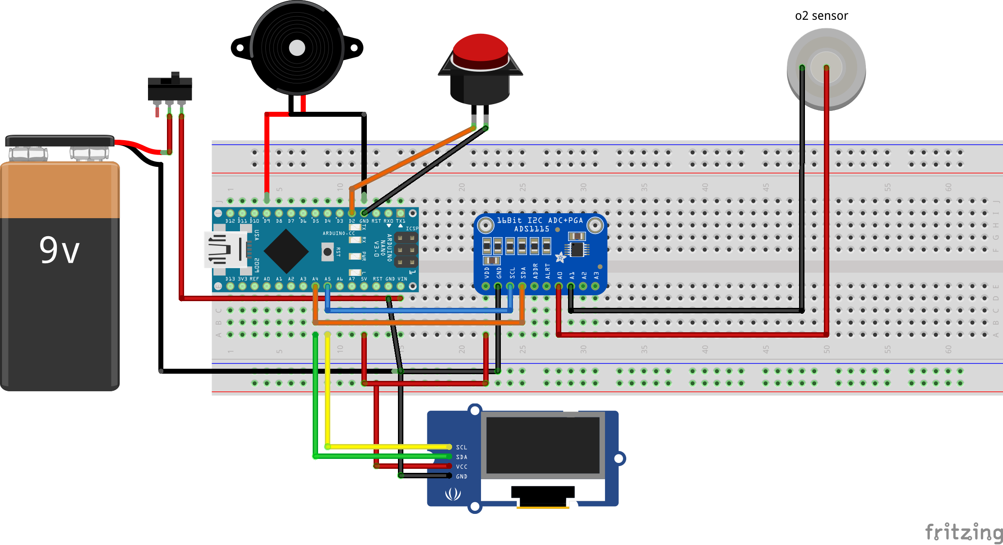
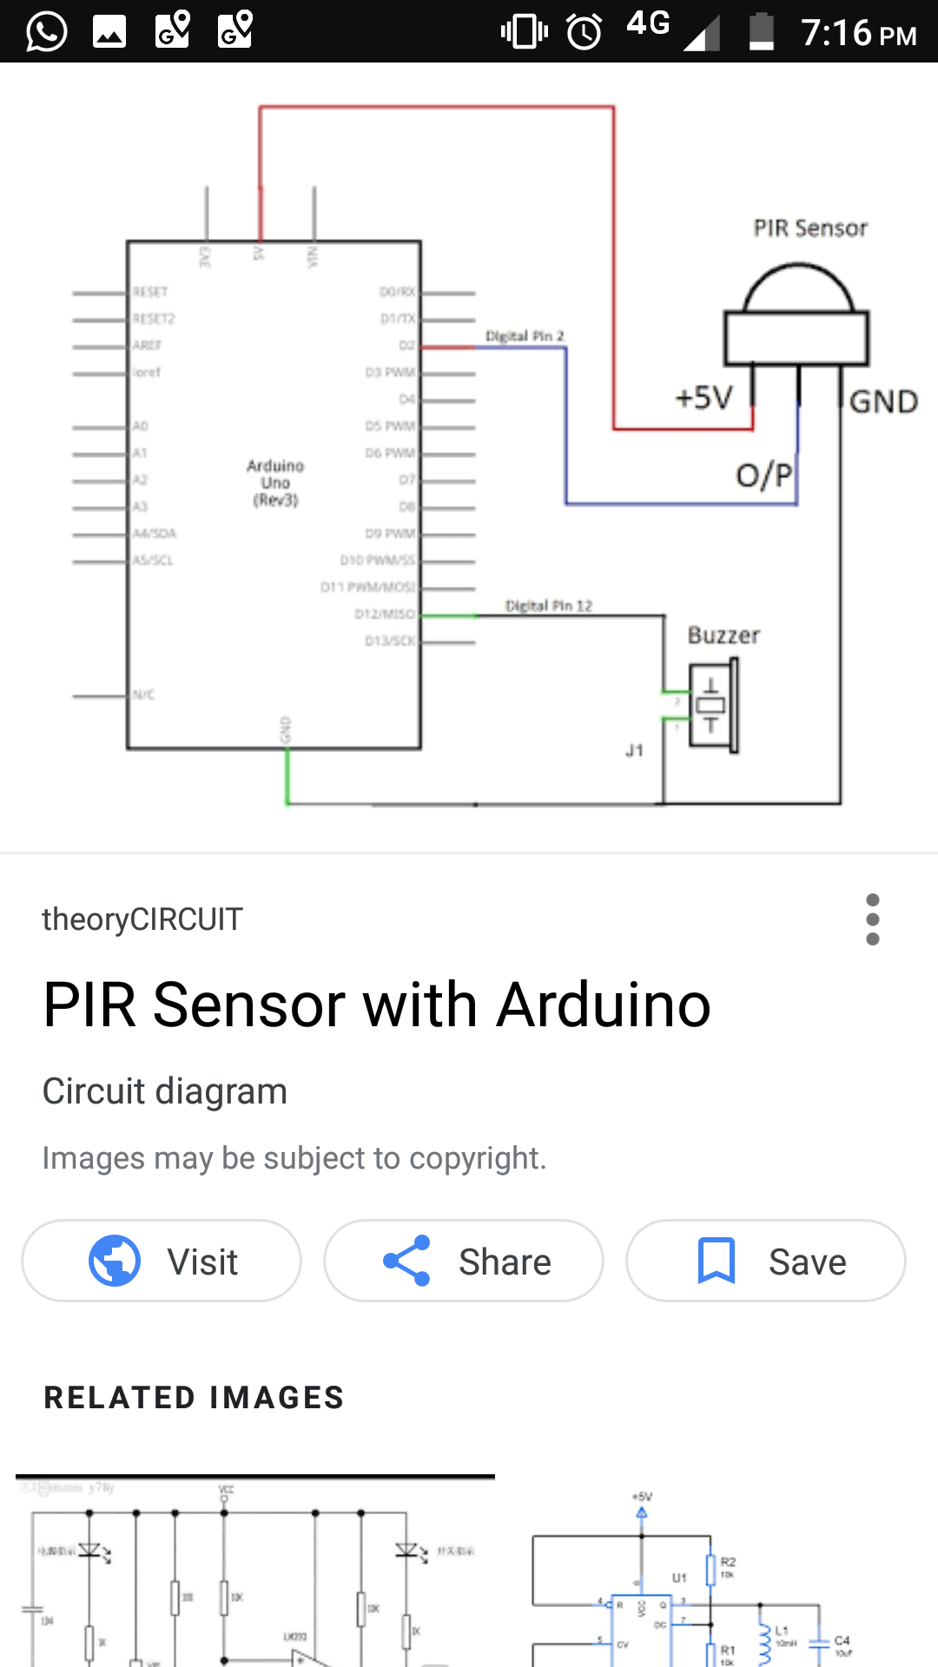
Oxygen Sensor
SMART OXYGEN AND TEMPERATURE CHANGER FOR CAR 2017-2018
Senses the level of oxygen in the surroundings in percentages

Slide 8
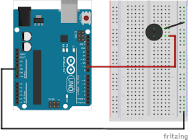
Buzzer
SMART OXYGEN AND TEMPERATURE CHANGER FOR CAR 2017-2018
The buzzer is switched on to bring in notice to the people in car that the oxygen level is low

Slide 9
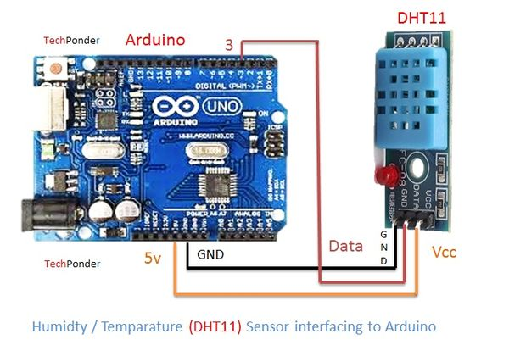
Temperature
SMART OXYGEN AND TEMPERATURE CHANGER FOR CAR 2017-2018
The temperature value will be obtained from this sensor to understand the room temperature

Slide 10
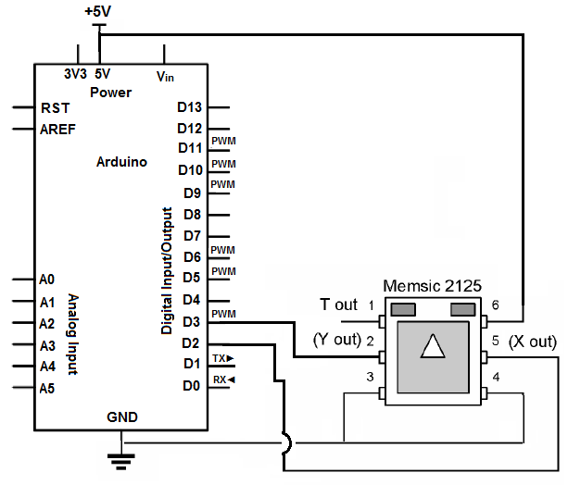
Accelerometer
SMART OXYGEN AND TEMPERATURE CHANGER FOR CAR 2017-2018
Senses weather the car is in motion or not

Slide 11
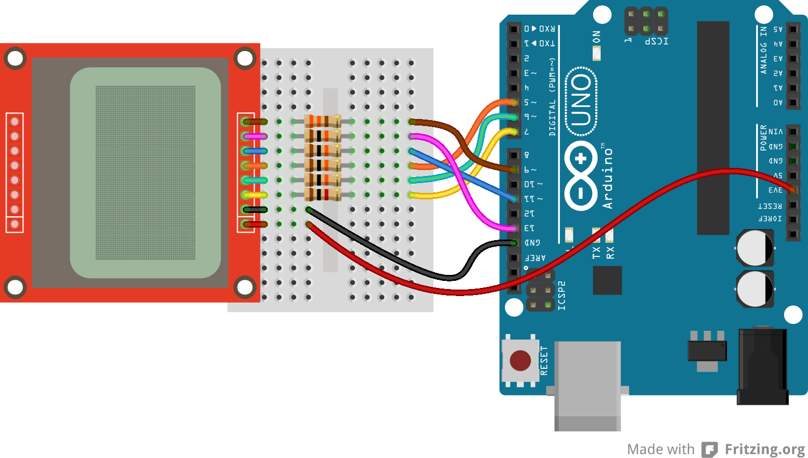
LED Display
SMART OXYGEN AND TEMPERATURE CHANGER FOR CAR 2017-2018
The output values of oxygen level and temperature is printed

Slide 12
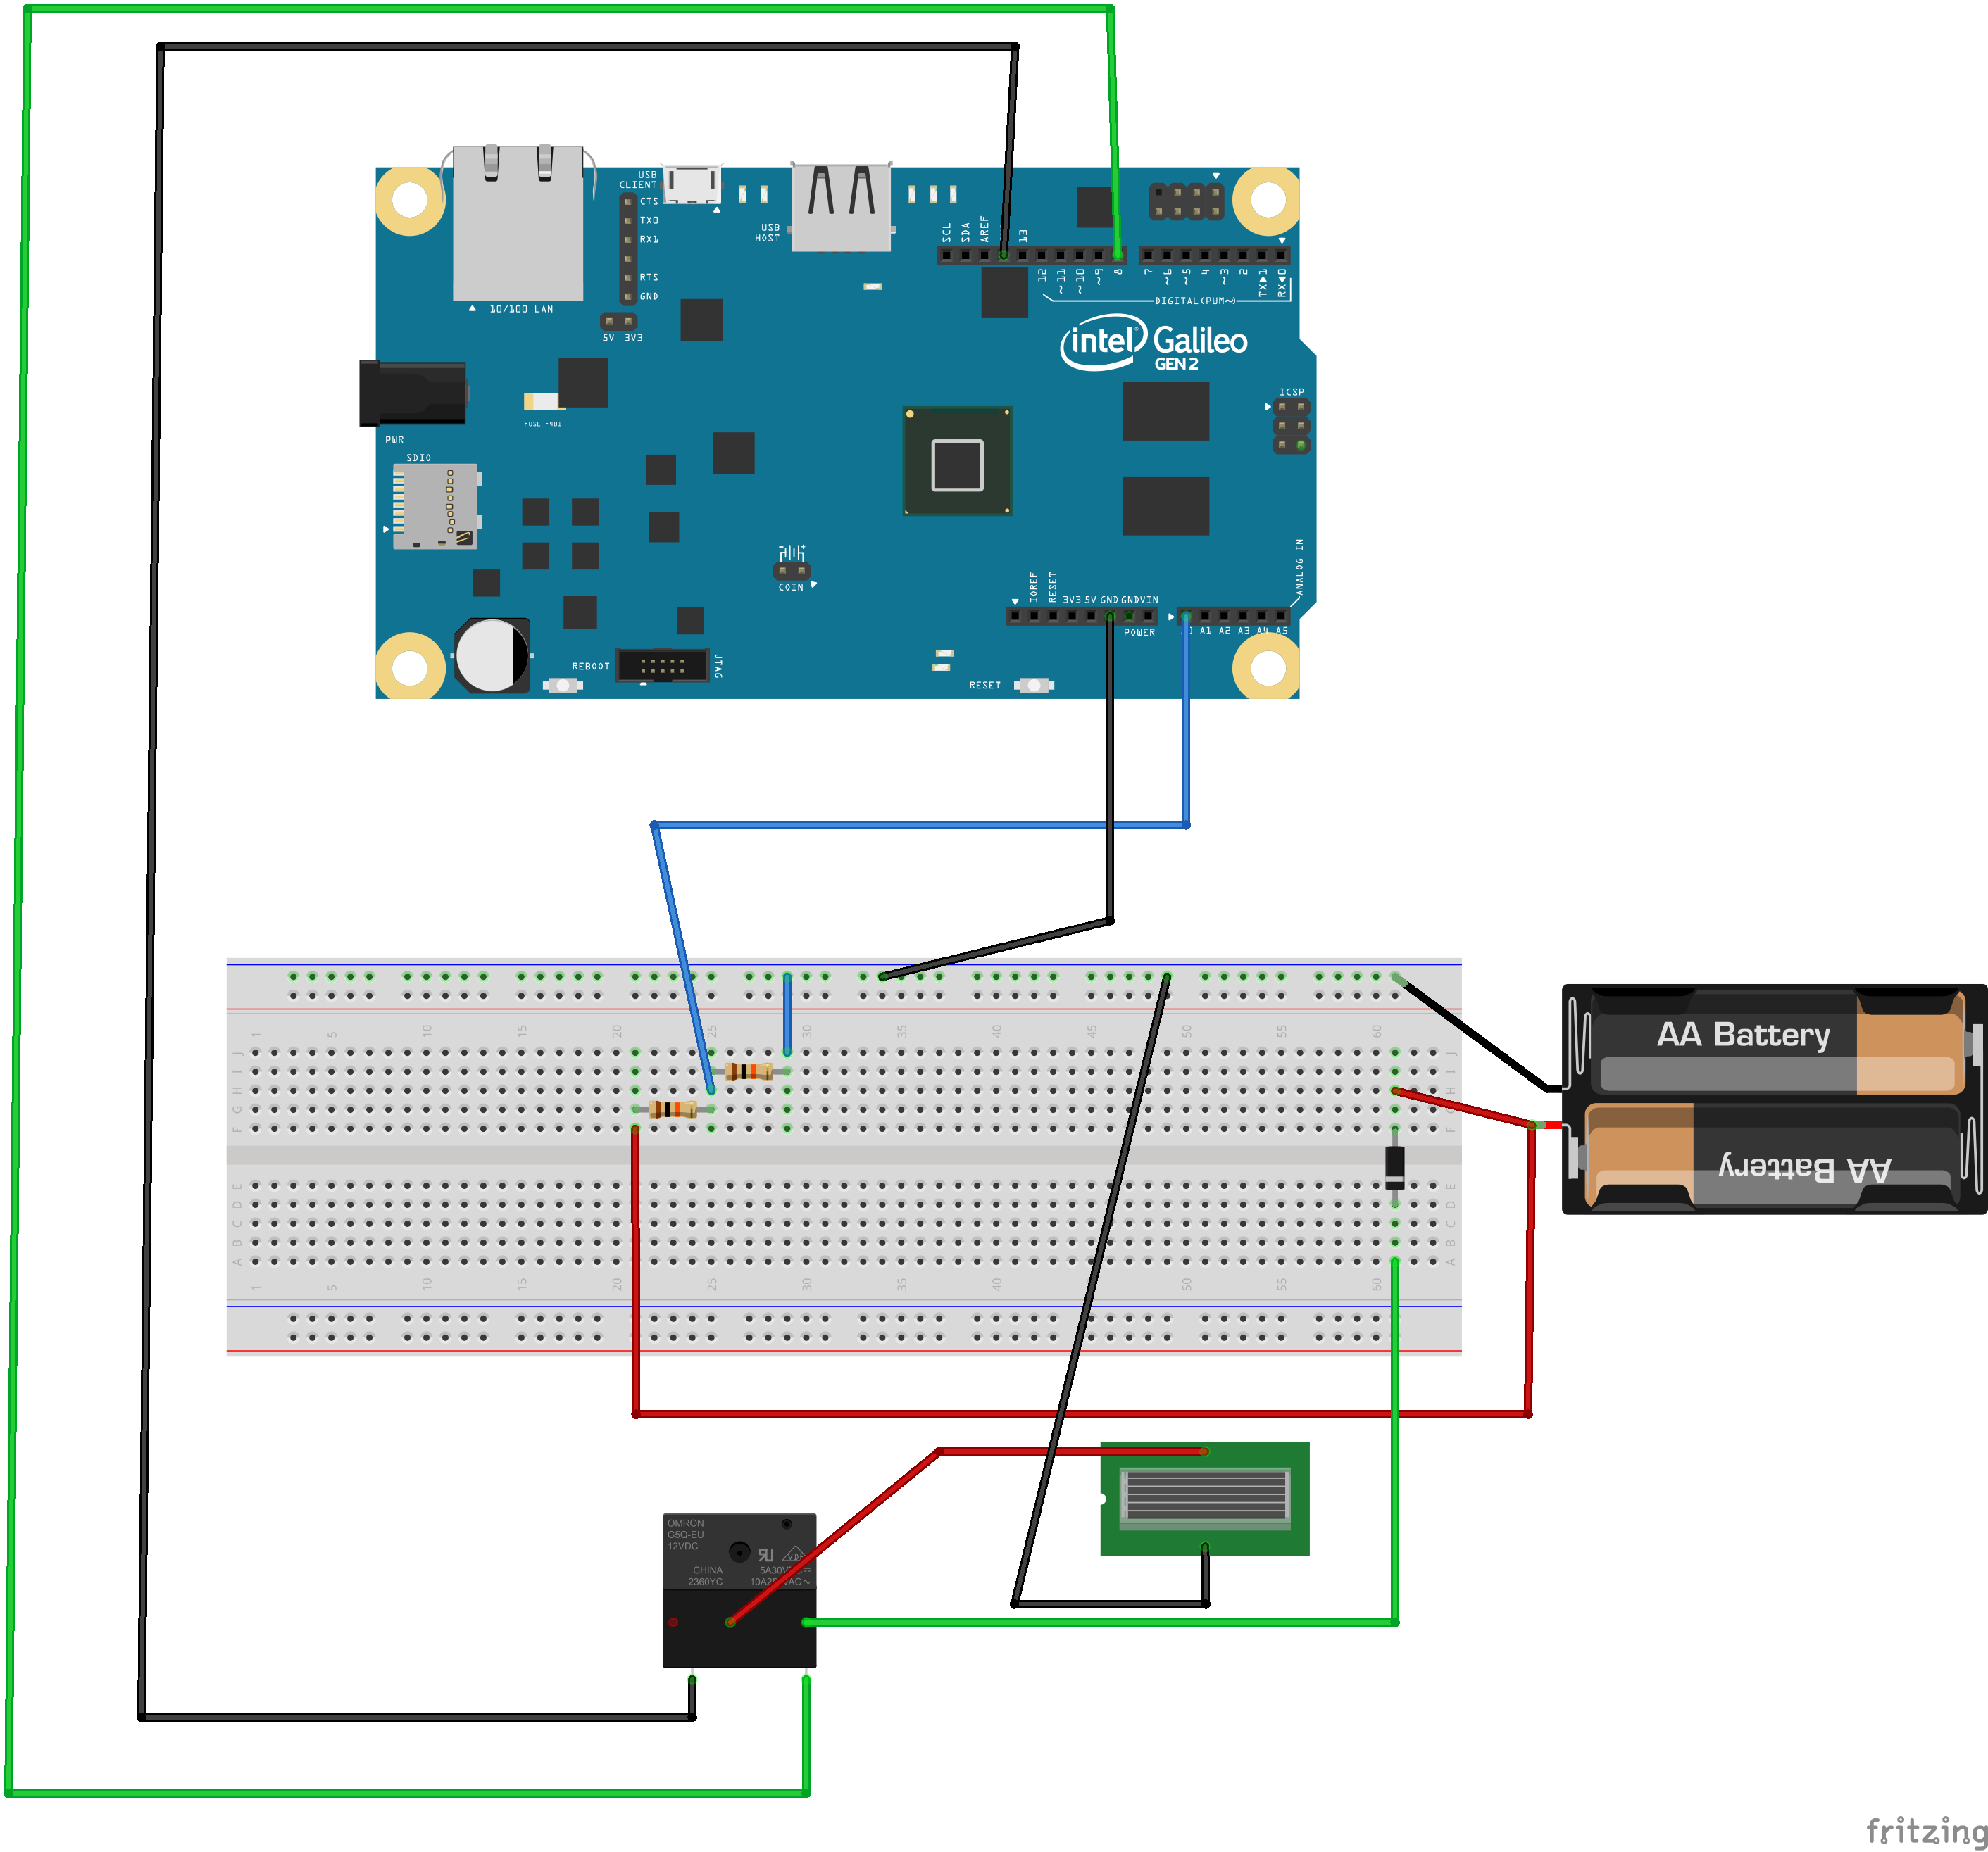
Solar Panel and battery
SMART OXYGEN AND TEMPERATURE CHANGER FOR CAR 2017-2018
Automatically power the circuit if the panel detects sunlight as well as charge the battery

